Slide 1
Solution Plan Overview (SP051) Mater Mater DevOps Pipeline Optimisation
0.0.1 27-Sep-2022 Mater Bus Apps Support - Simplify DevOps Pipelines

Slide 2
Version Control
Solution Plan
Version | Date | Author | Notes/Changes
<V0.0.1> | 20-Sep | Achroo Batta | Initial Version
Deal Artifacts
Version | Date | Author | File Name or Link | Notes/Changes
<V0.1> | <Date> | <Author> | < e.g. AEM / AEP, DPM, SOW > | <Initial Version>

Slide 3
Top Sheet: Solution-to-Win and Price-to-Win
General |  |  |  |  | Solution-to-Win |  |  |  |  |  | Price-to-Win
Client Name |  | Mater Hospital |  |  | Project Team Mix and Cost | Cost | % Hrs | % Cost | ABR |  | Price-to-Win
Opportunity Name |  | Mater Bus Apps Support - Simplify DevOps Pipelines |  |  | Onshore | 29,266 | 100% | 100% | 229 |  | Pricing Model | Time and Materials (T&M)
Project Start Date |  | 2022-10-03 |  |  | GCP | 0 | 0% | 0% | 0 |  | Billing Terms | BILL 1 MONTH AFTER
Project End Date |  | 2022-11-04 |  |  | ATC | 0 | 0% | 0% | 0 |  | Total Cost (with Capital Charges) | 30,181
Channel |  | Direct |  |  | Subcontractor | 0 | 0% | 0% | 0 |  | Services Revenue (Ex. VAT) | 45,726
Sales Motion |  | Direct |  |  | Total Services Cost | 29,266 | Total Hours |  | 200 |  | Expenses Revenue (Ex. VAT) | 0
Risk Tier |  |  |  |  | Inc Contingency | 852 | Sol. Contingency |  | 3% |  | Total Revenue | 45,726
CDP Risk Assessment |  |  |  |  | Total Expense Cost | 0 | Average Bill Rate |  | 229 |  | Project Margin | 34.00%
 |  |  |  |  |  |  | Average Cost Rate |  | 146 |  | Margin Target | Margin Floor | 42.00% | 40.00%
Offering Mix |  |  |  |  | Total Cost (without cap charges) | 29,266 | Capital Charges |  | 915 |  | Total Price (VAT + Expenses) | 45,726
1 | Secure Applications, Platforms & Data |  | 100%
2 |  |  |  |  | Solution-to-Win / Cost Comment: |  |  |  |  |  | Price-to-Win Comment:
3
4
5

Slide 4
Opportunity Background
Client contacts
Proposal Status
Anand Veeramallu (Senior Manager Digital Solutions)
N/A
Mater, identified the need to optimize DevOps Pipeline for its CRM projects. Mater is seeking to select a partner who will assist with delivery of DevOps initiatives in MaterAtHome and MaterAtFoundation projects. Mater as a part of the response expecting Avanade to provide approach, better practices, timeline, resources and pricing for each of the listed requirement (as below).
Mater also, expecting the delivery to start at the earliest mutually agreed time between them and their preferred partner.
Below is the high level scope items given by Mater
Migrate code repositories from Github to Azure Repos
Consolidate Azure DevOps pipeline under one Azure DevOps project
Optimize Azure DevOps pipeline to run faster

Slide 5
Scope Definition
Scope is limited to the definition provided herein:
Scope of Work
Use Microsoft Power Platform tool extensions instead of PowerShell commands two CRM projects (MaterAtHome and MaterAtFoundation)
Migrate code repositories from Github to Azure repos for MaterAtHome. MaterFoundation is already using Azure Repos.
Migrate both Azure DevOps pipeline under one CRM project
Migrate Power Platform STAGING (unmanaged) to UAT (managed) for MaterAtHome
Follow Microsoft best practices to securely deploy code to Power platform using Azure service principal
Key Outputs
Receive notification at teams regarding the progress of pipeline
Lesser time for completion of pipeline saving time for the team
Streamlining and consolidating projects under one CRM project
Azure Repos for storing the code and artifactory for storing the artifacts.
POC, Low-level Design Document, Modified Azure DevOps Pipeline
Out of Scope
Mater ERP pipeline is not considered as a part of this optimization project, because of dependency on the complex way of building the project, which is possible only through PowerShell scripts. Also, only regular user credentials must be used which is a security risk. We will follow current method of building/deploying ERP project.
Anything else not mentioned in scope of work.
ETA slide

Slide 6
Delivery Approach Overview
Delivery Approach
Iterative delivery approach. Project is divided into three phases, At the end of each phase, workshop with client to showcase progress of the project.
Project development Team will help in validating the outcome of the pipelines.
Sourcing Strategy
DevOps Consultant (100% capacity for 5 weeks) will implement the pipelines for both the project.
ETA slide

Slide 7
Indicative High Level Schedule
 | Avanade activity
 | Client activity
 | Key milestone
 | Work Product
1
Dependency
Note: This schedule provides indicative timeline ONLY. It will change based on overall solution and delivery approach and is to be validated as part of overall solution and during mobilization.
Deliverable
Track | W1 | W2 | W2 | W4 | W2 | W6 | W4 | W8 | W3 | W10 | W11 | W12 | W4 | W14 | W15 | W16 | W5 | W18 | W19 | W20
POC
Low-Level Design Document
Build pipeline for MaterFoundation
Build pipeline for MaterAtHome
Deployment
Improvements
Analysis, POC creation in POC environments and low-level design document
workshop2
Build and Unit Test Pipelines in POC Environments
workshop1
Deployment/Improvements
Design document & POC
Build Pipelines
NOTES:
Initiate of this project should start on completion of the following things: -
User has access to github MaterAtHome project
User has access to create pipeline in Mater Azure DevOps environment and service principal in Azure AD
POC Dev and POC test environments are created and code is copied in POC Dev environment for MAH20CustomizingNew
ETA slide

Slide 8
Estimation Basis
Project Staffing
Model | Team | Role Description | Named Member | Project Assigned Role | Skills | Level | Location | Rate Card | Bill Code | Start Date | End Date | Time Type | Hrs/Week | Hours | % of Total Hours
Mater DevOps Pipeline Optimisation | Default Team | DevOps Lead |  | DevOps Engineer | Github, Azure DevOps, Power Platform Builld Tool | Consultant | Australia | Client DO ST | 54 | 2022-10-03 | 2022-11-04 | AHPW | 40.00 | 200 | 100.00%
Inventory / Components
Output | Days | Count | Comments
Analysis, POC & Low-Level Design | 10 |  | Analysis – understand project, tools and environment POC – What are the expectations and actual execution. Document detailing pipeline flow and name and extensions used in pipeline (include relevant screenshots)
Build | 10 | 2 | Pipelines for two projects in POC environments.
Deployment/Testing/Fix | 5 |  | Deploy pipelines in real environment. Get feedbacks.
Requirement | In Scope | Count | Comments
MaterAtHome | Yes |  | Access to Azure DevOps, Github and Power Platform Environments
MaterAtFoundation | Yes |  | Access to Azure DevOps and Power Platform Environments

Slide 9
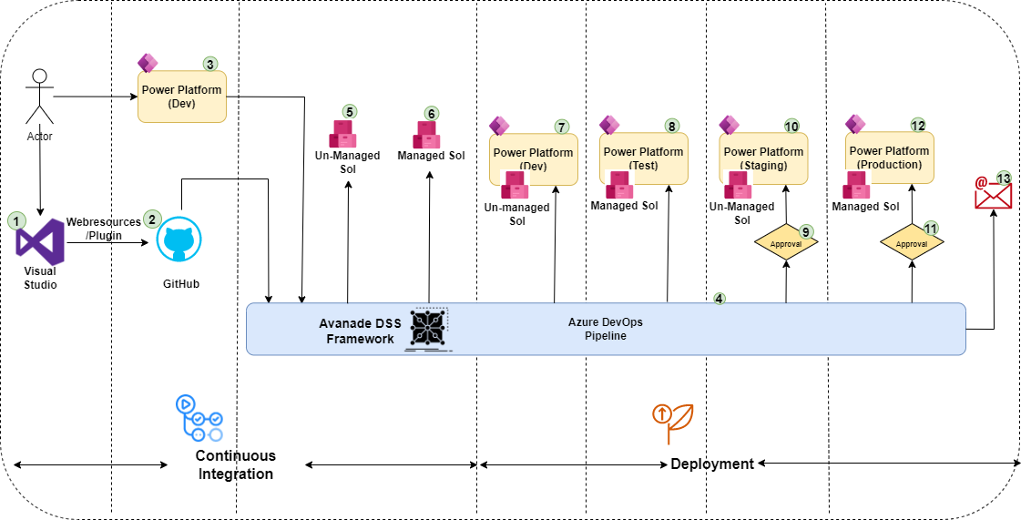
Solution Blueprint - Current (MaterAtHome)
ETA slide

Slide 10
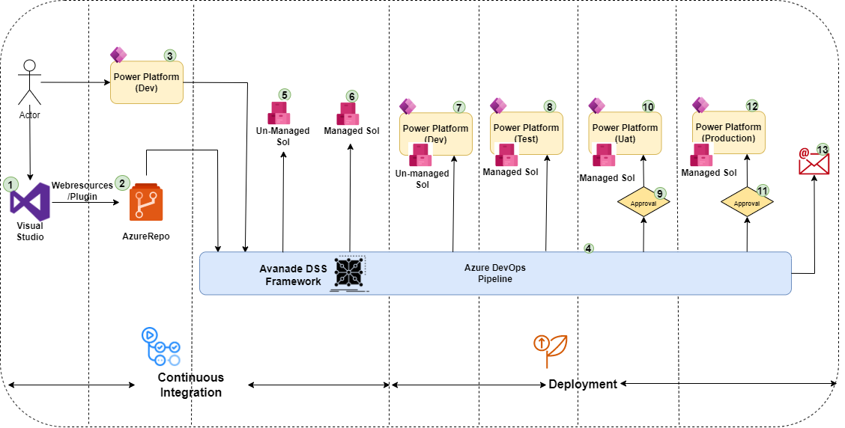
Solution Blueprint - Current (MaterFoundation)
ETA slide

Slide 11
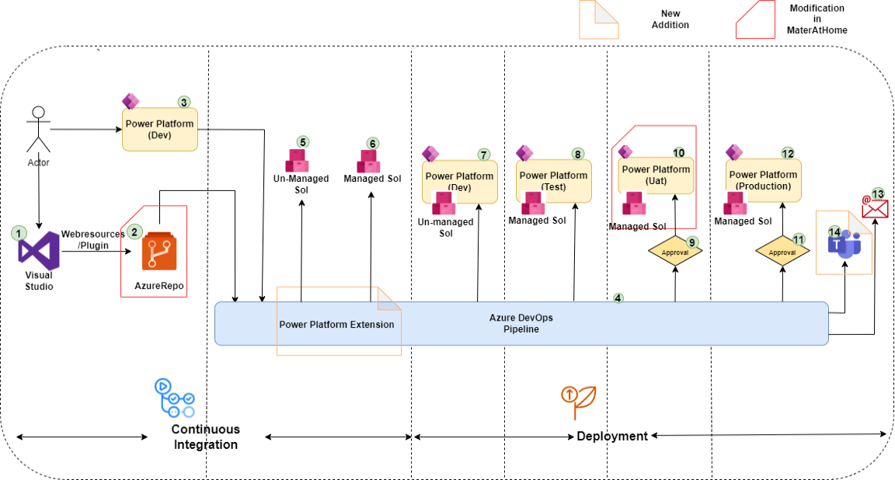
Solution Blueprint – Proposed (MaterAtHome, MaterFoundation)
ETA slide

Slide 12
Work Products & Deliverables
Title | Description | Format | Any Acceptance Criteria | Type
Low-Level Design Document | This document will contain name of the Azure Repos, Pipelines, Power Platform Extension and other azure devops tools used in the pipeline. This document will also demonstrate instructions to run pipeline/on how to choose stages to deploy. | MS Word | Workshop with Client | Workshop
POC | Azure devops pipeline which will build MAH10Webresources and MAH20CustomizingNew as a managed and unmanaged solution store it in Azure Artifactory. This POC will also deploy solution to POC Dev and POC Test environment. | YAML | Validate by Mater Developers | Workshop
Azure DevOps Pipeline | Azure devops pipeline for MaterAtHome an MaterFoundation which build and deploy all the components in POC dev and Poc Test and framework for Uat and Prod. | YAML | Validate by Mater Developers | Workshop
Acceptance Process for Deliverables
Mater developers will validate the output produced by the pipeline and it can be compared against artifacts produced by existing devops pipeline.
ETA slide

Slide 13
Key External Dependencies/Obligations
# | Dependency | Impact | By When | Obligation With | Comments
1 | Access to Github Mater account | POC work can not be started | Before start of the project | Mater Team
2 | Creation fo Mater account and provide access to Azure DevOps | POC work can not be started | Before start of the project | Mater Team
3 | POC Dev and POC Test environment | POC work can not be started | Before start of the project | Mater and MaterAtHome Developer
4 | Access to Azure AD of Mater/Service Account | POC Work will be delayed | Before start of the project | Mater Team
5 | Migration of MaterAtHome Staging (Unmanaged) to Uat (Managed) | Deployment phase will be delayed | Before the commencement of Build/Deployment phase | Mater and MaterAtHome Developer
ETA slide

Slide 14
Key Assumptions
# | Assumption | Verification | Impact | Owner | Comments
1 | Azure AD subscription accounts can be linked with M365 subscription | By creating an azure AD service principal and assigning admin role in one of environment | High | Mater and Avanade ATC
ETA slide

Slide 15
MANDATORY
Key Risks
Slide Purpose: Provides an overview of the top risks in descending order and the tangible mitigation actions that are being taken against or have been incorporated into the solution.
Key Note:
A risk is something that is yet to happen, and represents something that could adversely impact a project and or estimate. Any risk mitigation actions should be captured and tracked in a risk control log, and explicitly detail where the risk is being, or will be, managed e.g. within the Solution Plan, the contract, the sourcing approach, delivery etc.
Instructions:
Do NOT delete this slide under any circumstances
Focus on the key risks that could materially implicate the accuracy of the estimate and or Client expectations.
Populate all text formatted <like this>
Delete this message upon completion
# | Risk | Consequence | Mitigation Action(s) & Date | Impact | Probability | Owner | Comments
1 | <insert risk title - succinct> <insert risk description – what is the potential problem?> | <insert consequence – what happens if the risk is not resolved> | <detail mitigation – what steps are being taken to avoid the risk occurring and by when do they need to take place> | <H / M / L> | <H / M / L> | <identify who owns the risk mitigation steps> | <insert notes from QAD review etc>
Sticky note to use during solutioning
ETA slide

Slide 16
Role and Responsibilities - Solution RACI
Activity/Task | Client | Avanade Onshore | Avanade ATC
Access to Mater Azure DevOps, Github and Azure AD | RA | I
Creation of POC Dev and Test Environment | AC | I | RA
Creation of Azure AD service principal | C | RA
Component installation in POC Dev | I | I | RA
Migration of Staging (Unmanaged) to Uat (Managed) for MaterAtHome | C | I | RA
POC and Low-level design document creation | CI | RA | C
Pipeline creation | CI | RA | C
Validation of Deployment | I | RA | RAC
Feedback/suggestions | C | RA | C
Key
R | Responsible: Those who do the work to achieve the task. There is typically one role with a participation type of Responsible, although others can be delegated to assist in the work required.
A | Accountable: Sometimes also knows as Approver or final Approving authority. This is the one ultimately accountable for the correct and thorough completion of the deliverable or task. An Accountable must sign off (Approve) work that a Responsible provides. There must be only one Accountable specified for each task or deliverable.
C | Consulted: Those whose opinions are sought; and with whom there is two-way communication.
I | Informed: Those who are kept up-to-date on progress, often only on completion of the task or deliverable; and with whom there is just one-way communication.

Slide 17
Appendix A – Supplementary slides
Additional slides, including examples of mandatory/optional slides, to use if required.

Slide 18
Payment / Contract Milestones
MANDATORY
Slide Purpose: Provides for an overview of how the payment profile maps to the solution phases/stages and/or related work products and Deliverables.
Instructions:
Do NOT delete this slide under any circumstances
Where no Work Products or Deliverables are linked to a Milestone state ‘NA’
Check the payment profile is aligned with the DPM ‘ODE Output’ tab.
Populate all text formatted <like this>
Delete this message upon completion
# | Milestone | Description | Linked Work Products | Linked Deliverables | Date Due | Invoice Value (exc. VAT)
1 | <Name of Milestone> | <What phase/stage of the solution delivery does that fall in, and does the milestone signify phase/stage completion?> | <Link any Work Products linked to this Milestone> | <List any Deliverables linked to this Milestone> | <What is the Target Due Date for the Milestone?> | < Invoice amount?>
2
3
4
5
6
7
8
 |  |  |  |  | Total | <Total value>
Sticky note to use during solutioning

